Slide 1
Technical and Business Writing
Miss. Aqsa Ashraf
ENG-201
Week 4, Lecture 3

Slide 2
Organizing information and generation solution

Slide 3




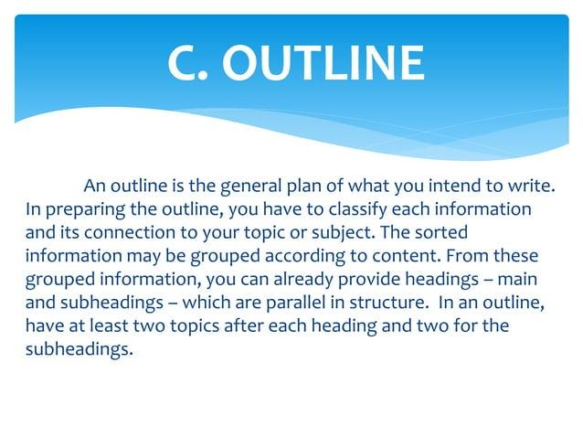

www.tuf.edu.pk
unioffaisalabad

Slide 4
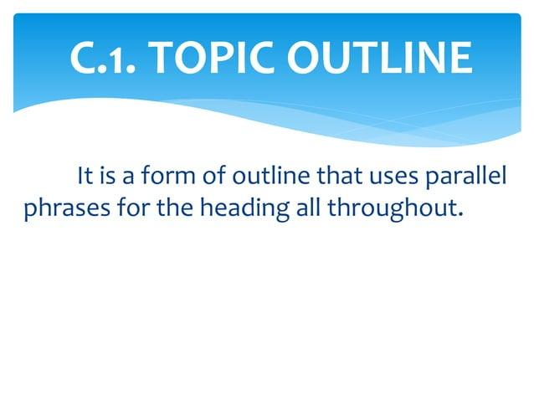
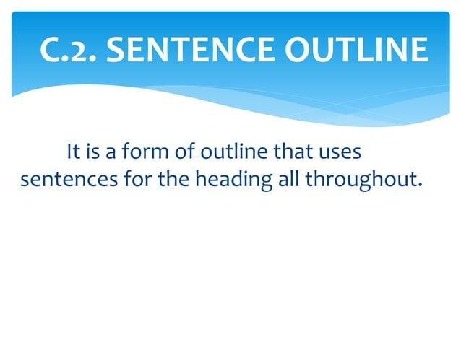
www.tuf.edu.pk
unioffaisalabad

Slide 5
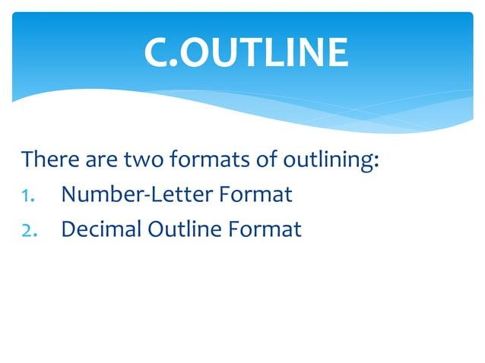
www.tuf.edu.pk
unioffaisalabad

Slide 6
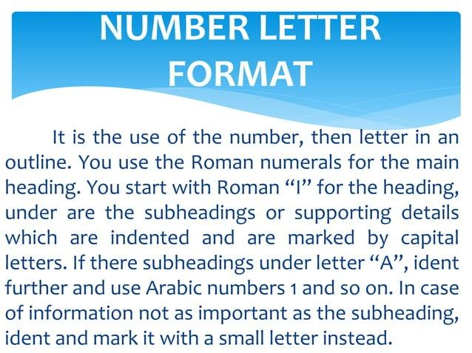
www.tuf.edu.pk
unioffaisalabad

Slide 7
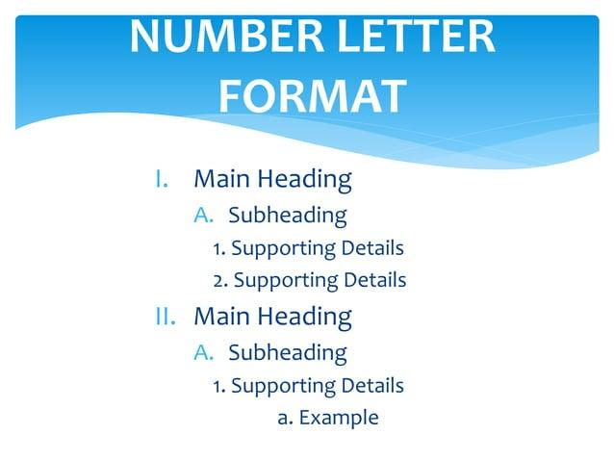
www.tuf.edu.pk
unioffaisalabad

Slide 8
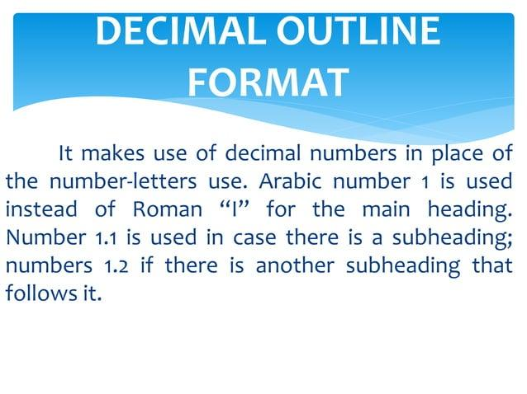
www.tuf.edu.pk
unioffaisalabad

Slide 9
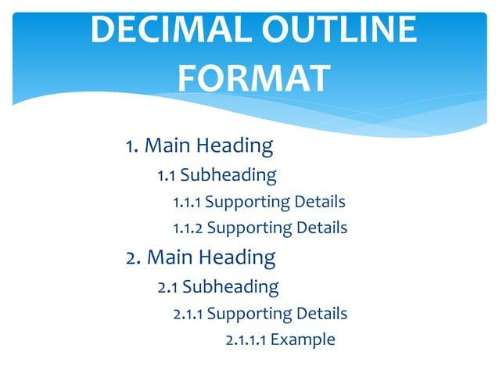
www.tuf.edu.pk
unioffaisalabad

Slide 10

www.tuf.edu.pk
unioffaisalabad

Slide 11
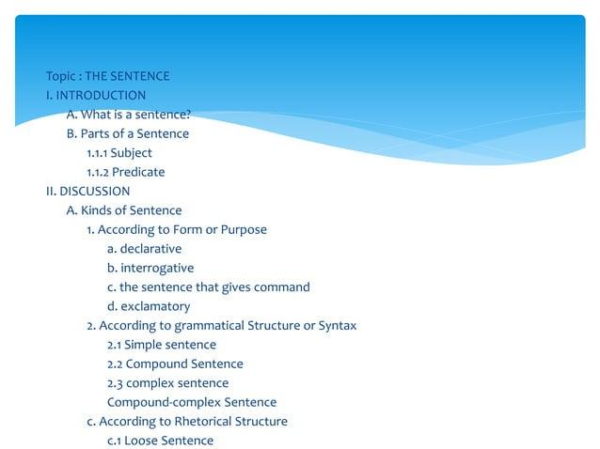
www.tuf.edu.pk
unioffaisalabad

Slide 12
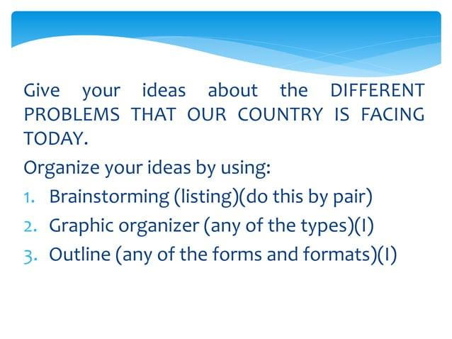
www.tuf.edu.pk
unioffaisalabad

